Slide 1
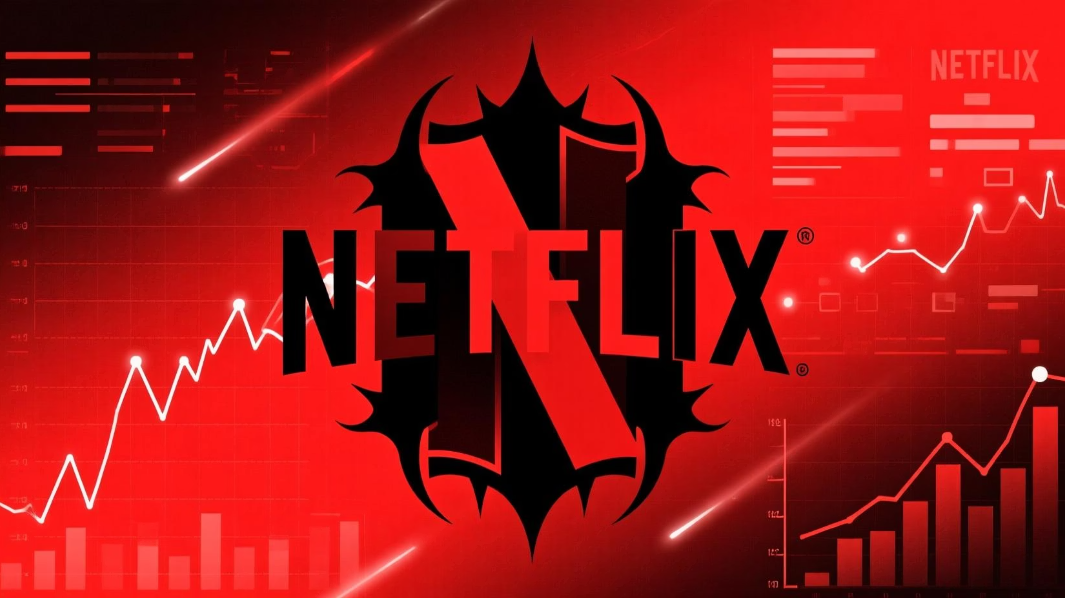
Netflix Global Content Performance Dashboard
Starting 2020 – Data Analysis & Insights
Presented by: Shaurya Chaturvedi
Admission Number: 23scse1012647

Slide 2
Unveiling Netflix's Content Landscape
This analysis dives deep into Netflix's content data from 2020 onwards to reveal key trends and patterns. Our objective is to understand content growth, audience reception, and the distribution of movies versus shows, providing actionable insights for strategic decision-making.

Slide 3
Dataset Overview & Methodology
Dataset Origin:
Key Attributes:
Sourced from Kaggle.com, our dataset provides a comprehensive look at Netflix's content catalog.
Total titles available
IMDB & TMDB ratings for each title
Analytical Tools:
Total runtime of content (in hours)
Information on actors and directors
All data processing and visualization were performed using POWER BI, leveraging its robust capabilities for interactive dashboards.
Content type (Movies vs. Shows)
Release year and yearly content growth

Slide 4
Data Refinement Process
01
02
03
Data Cleansing
Format Standardization
Type Conversion
Identified and removed duplicate entries. Addressed missing values to ensure data integrity.
Standardized content runtime into a consistent "hours" format for accurate aggregation and comparison.
Converted "release year" to a date data type, facilitating time-series analysis and trend identification.
04
05
Calculated Columns
Rating Consistency
Generated new columns, such as "Movies vs. Shows split," to derive deeper insights and enable specific analyses.
Ensured uniformity in IMDB and TMDB rating scales for reliable comparison and average calculations.

Slide 5
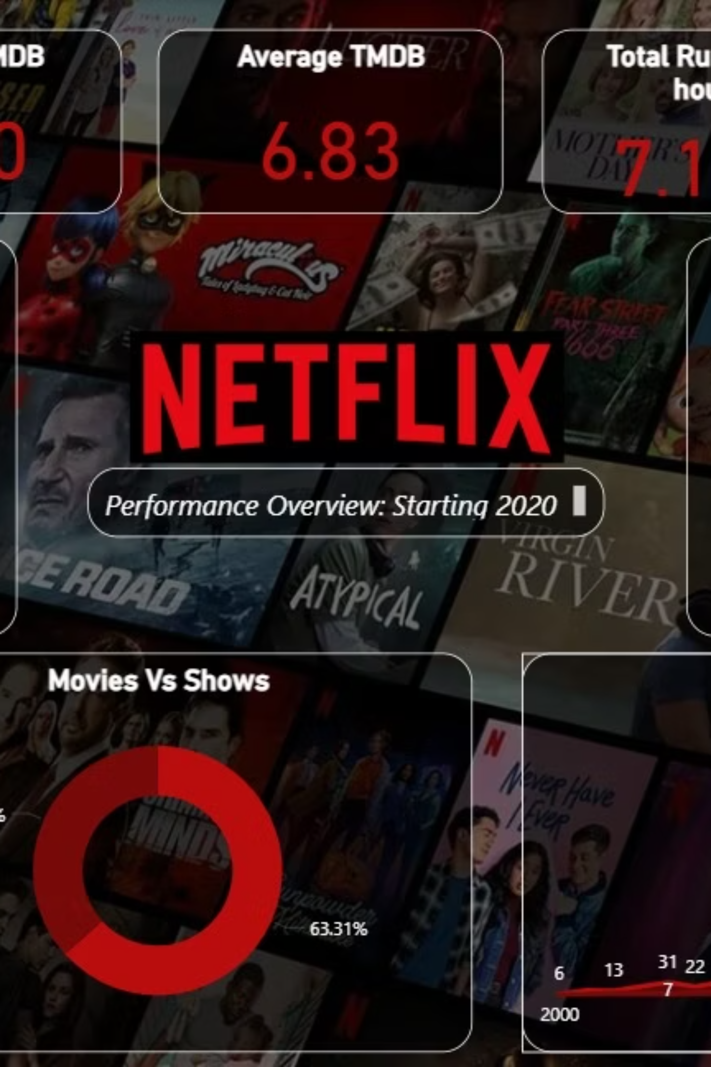
Dashboard Snapshot: Key Performance Indicators
Our interactive dashboard consolidates critical metrics, offering a quick overview of Netflix's content performance.
5645
6.50
6.83
Total Titles
Average IMDB Score
Average TMDB Score
The cumulative count of movies and shows available on the platform since 2020.
Reflecting general audience perception on a widely recognized rating platform.
Indicating content popularity and quality as rated by the TMDB community.
7.15K
Total Runtime (Hours)
The aggregated duration of all content, showcasing the sheer volume of available viewing.

Slide 6
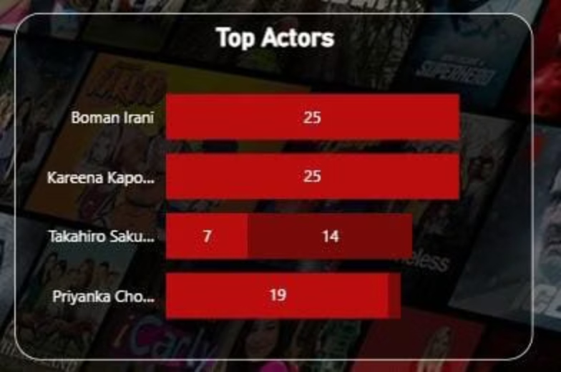
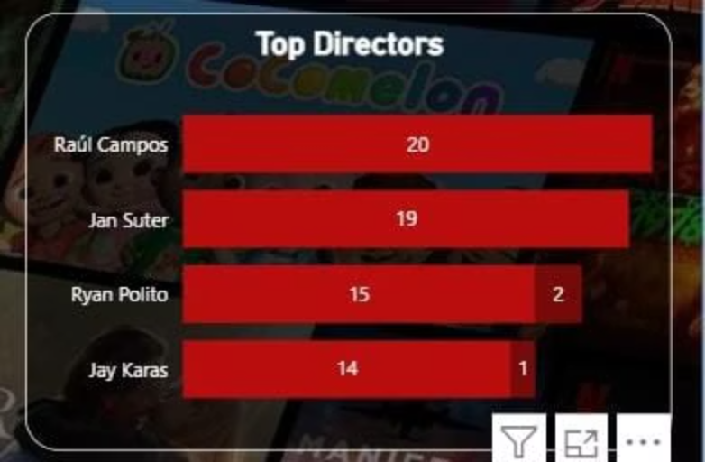
Influential Talents: Top Actors & Directors
Identifying the key creatives driving Netflix's content pipeline reveals frequently featured individuals.
Top Actors Spotlight:
Leading Directors Identified:
Analysis highlights frequent appearances by actors such as Boman Irani and Kareena Kapoor, indicating their significant presence across various Netflix productions.
Similarly, directors like Raúl Campos and Jan Suter frequently helm Netflix titles, suggesting their consistent contribution to the platform's content strategy.

Slide 7
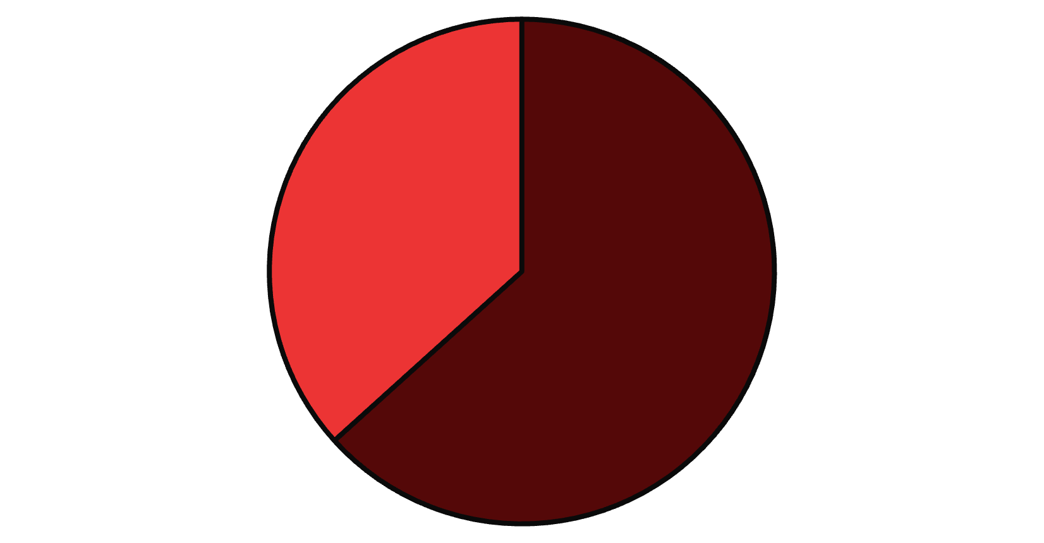
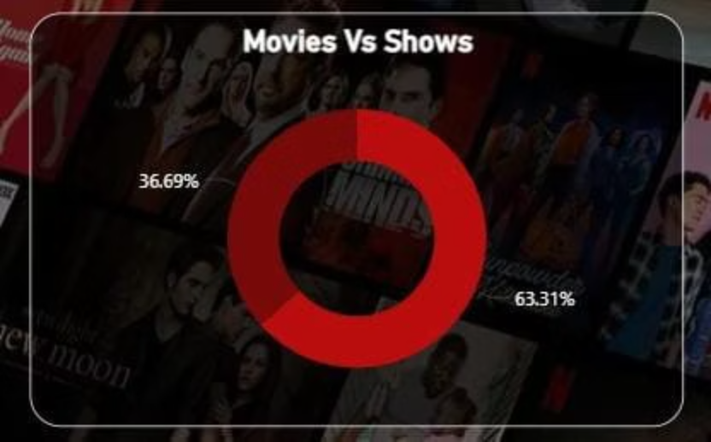
Movies vs. Shows: Content Dominance
Our analysis reveals that movies constitute the majority of Netflix's library, making up approximately two-thirds of the platform's content. While shows are a significant part of the offering, they currently hold a smaller share.
Movies
Shows

Slide 8
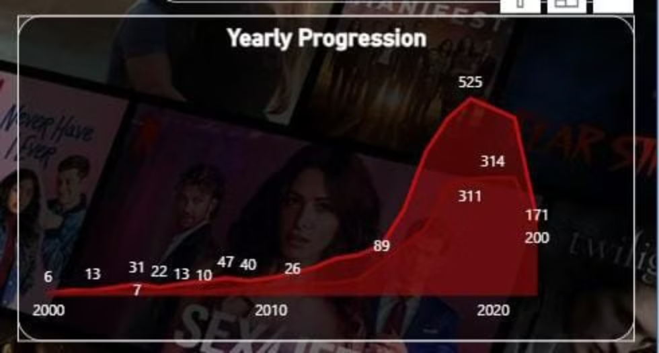
Content Expansion: A Yearly Progression
Netflix's content growth has followed a remarkable trajectory, with significant acceleration in recent years.
Early Growth (2000-2015):
The platform experienced a steady and consistent increase in content, laying the groundwork for future expansion.
Post-2018 Surge:
A substantial acceleration in content acquisition and production began post-2018, culminating in a peak around 2020. This period marks Netflix's most aggressive content push.

Slide 9
Key Insights & Discoveries
Movie Dominance & Show Growth
Frequent Collaborators
Movies form the backbone of Netflix's content library, but TV shows are steadily increasing their footprint, indicating a strategic diversification.
Specific actors and directors are consistently featured, suggesting strong partnerships and a preferred pool of talent for Netflix productions.
Peak Content Expansion
Moderate Quality Ratings
The year 2020 marked the zenith of Netflix's content additions, following a significant post-2018 acceleration phase.
Average IMDB and TMDB ratings hover between 6 and 7, indicating a consistent but moderate quality perception across the platform's content.

Slide 10
Strategic Conclusions & Future Recommendations
Conclusion:
Recommendations:
Netflix has achieved rapid expansion, particularly since 2018, establishing a vast content library.
Prioritize content with higher rating potential to improve overall quality perception.
Both movies and shows are crucial pillars, contributing to the platform's diverse appeal.
Strategically expand the TV show category to achieve better content type balance.
Continue to leverage and strengthen collaborations with top-performing actors and directors.
Utilize data-driven insights more actively for future content acquisition and greenlighting decisions.
Thank you!

